Slide 1
Dynamic Knee Joint Stiffness 1 and 2 Years Post Anterior Cruciate Ligament Reconstruction
Julian Ng-Thow-Hing¹, Jade He^{2, 3}, Adam LC Wadsworth², Constance R Chu^{2,3}
¹Homestead High School ²Department of Orthopaedic Surgery, Stanford University, Redwood City, CA; ³Palo Alto Veterans Affairs Health Care System, Palo Alto, CA
All authors have no relevant financial disclosure or conflict of interest.
ACL and Meniscus Injury, ORS Annual Meeting, February 6, 2024

Slide 2
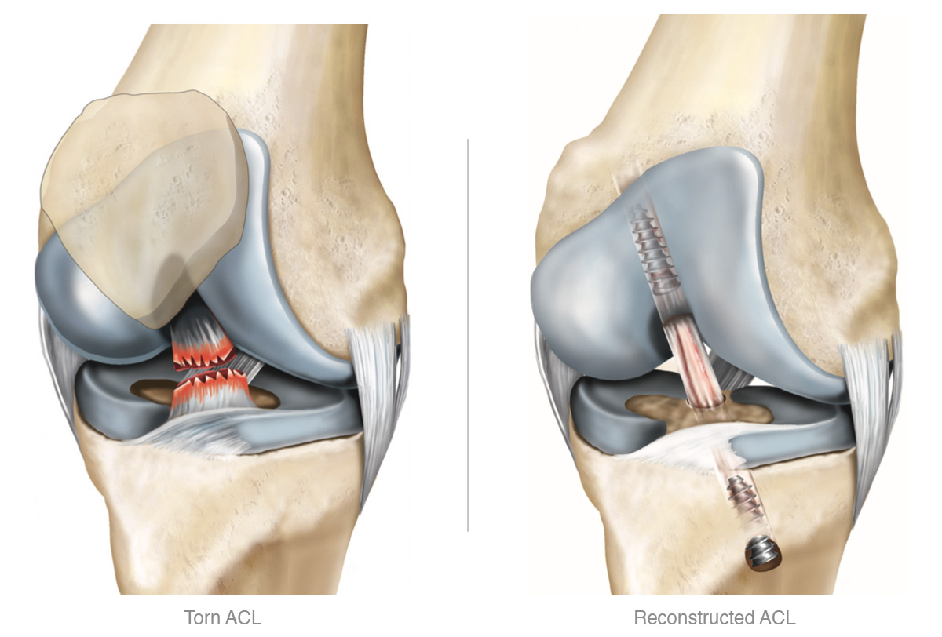
Anterior Cruciate Ligament Reconstruction (ACLR)
Joint injuries such as ACL tears greatly increase the risk of knee osteoarthritis²
ACL reconstruction is performed to stabilize the knee but has not been shown to:
Reduce OA risk
Normalize knee mechanics
Altered knee mechanics have been implicated in worse outcomes and OA development after ACLR^{1–3}
Illustration from North West Hip & Knee Clinic
¹Zabala ME, et al, J Biomech 2013. ²Titchenal MR, et al. Am J Sports Med 2018. ³Erhart-Hledik JC, et al. J Orthop Res 2017.

Slide 3
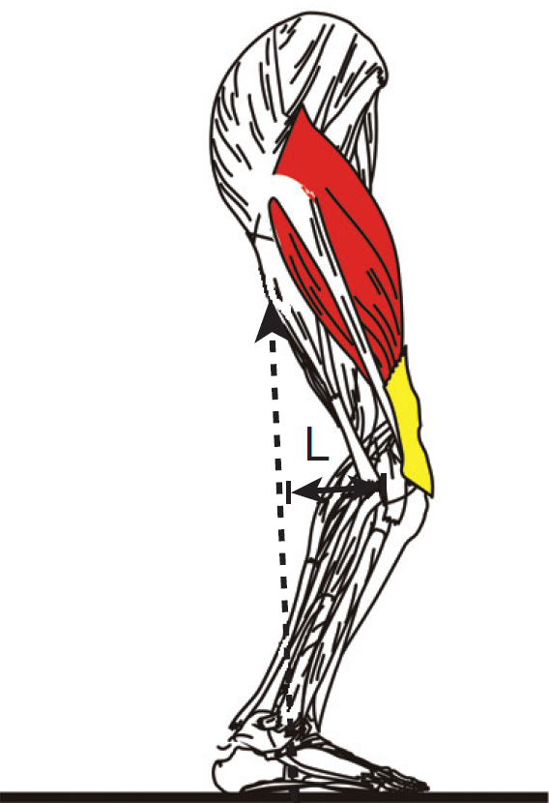
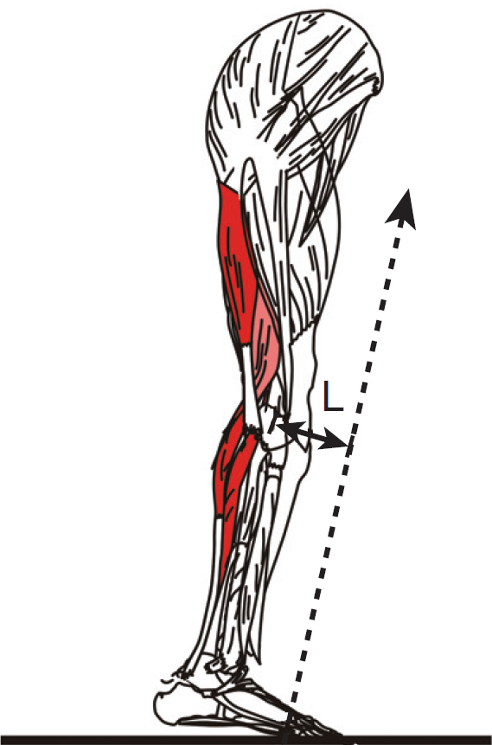
ACLR Knee Sagittal-Plane Mechanics
Knee Flexion Angle (KFA)^{1,2}
ACLR < Contralateral (CL) 6-12M
ACLR ~ CL between 1-3Y
Knee Flexion Moment (KFM)^{1,2}
ACLR < CL between 6-12M, 1-3Y
Abnormal sagittal-plane knee mechanics in ACLR knees have been associated with^{3,4}
Lower quadriceps strength
Altered quadriceps activity
Early Stance
Late Stance
Force
Force
Figures adapted from Scanlan SF & Andriacchi TP, 2017
[1] Hart HF et al. Br J Sports Med. 2016. [2] Kaur M, et al. Sports Med. 2016. [3] Pietrosimone B, et al. J Athl Train. 2021. [4] Blackburn T, et al. Clin Biomech (Bristol, Avon). 2019.

Slide 4
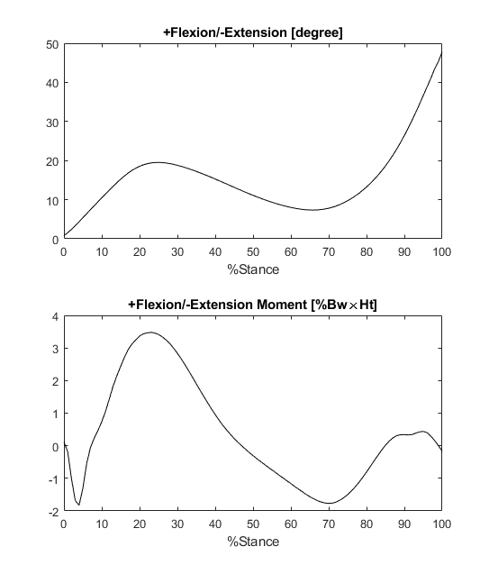
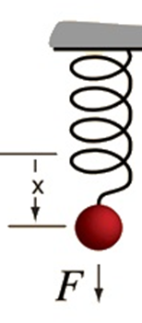
Dynamic Knee Joint Stiffness (DJS)
Dynamic Knee Joint Stiffness (DJS)¹
Likely adapted from Hooke's Law
Considers both KFA and KFM over a substantial proportion of stance (focuses past early stance)
Has been applied in analyzing OA knees and recently ACLR knees^{2,3}
F = kx
k: stiffness
KFM
DJS = =
KFA
¹Muller B, et al. AJSM 2016.²Williamson T et al, AJSM 2016. ³Larsen P et al, Knee 2023.

Slide 5
Purpose
To compare DJS between ACLR and contralateral (CL) intact knees 1 and 2 years post-ACLR and assess relationships between DJS and Patient Reported Outcomes (PRO).
Hypothesis1 : ACLR knees compared to CL knees show greater DJS.
Hypothesis 2: DJS of ACLR knees decreases from 1 to 2 years post-ACLR, and that greater DJS associates with worse PROs.

Slide 6
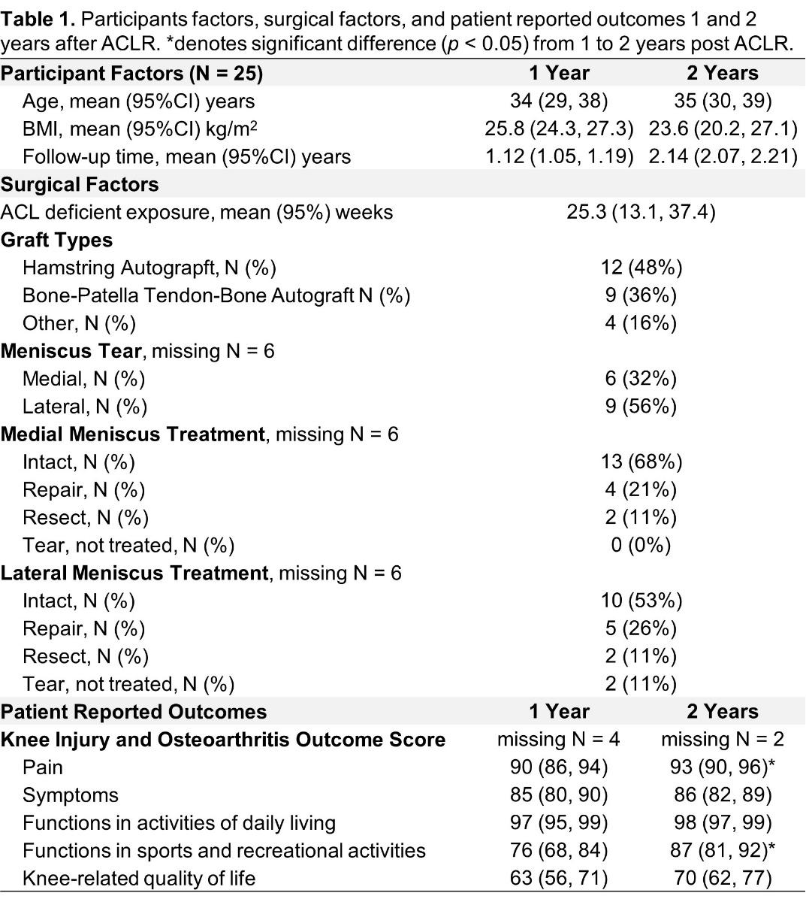
Participants
N = 25, (18 men, 7 women)
34 +/- 11 years
25.8 +/- 3.7 kg/m²
Completed KOOS and underwent gait tests after unilateral ACLR
1.1 ± 0.2 years
2.1 ± 0.2 years

Slide 7
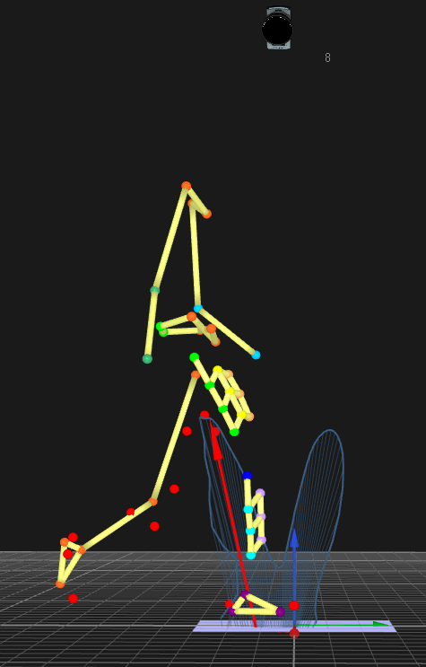
Gait Analysis
Participants performed three walking trials at a self-selected comfortable speed.
Marker trajectories and ground reaction force were acquired using a standard 3D motion capture system (Qualisys & Bertec)
External joint moments were expressed relative to the tibial frame and normalized to percent body weight multiplied by height (%BW×Ht).

Slide 8
DJS Calculation
Midstance: the interval between the KFA_{max} or KFM_{max} (KFM) and the peak knee extension moment (KEM)¹.
DJS: slope of the fitted linear regression line of KFM and KFA across midstance.
KFA_{max}
KFA_{min}
KFM
KEM
Midstance
¹Gustafson JA, et al. Gait Posture 2016.

Slide 9
Statistical Analysis
Variables of interest:
Primary: DJS
Secondary: KFA_{range}, KFA_{max}, KFA_{min}, KFM_{range}, KFM, KEM
Notes:
DJS between the ACLR and contralateral knees and between 1 year and 2 years post-ACLR were compared using two-way ANOVA. Significant results were further analyzed using pairwise comparisons with Bonferroni's corrections. Additionally, to gain insights into potential contributors to DJS side-to-side differences.

Slide 10
Statistical Analysis
Variables of interest:
Primary: DJS
Secondary: KFA_{range}, KFA_{max}, KFA_{min}, KFM_{range}, KFM, KEM
DJS between sides (ACLR vs. CL) and over time (1 vs. 2 years post-ACLR)
Two-way ANOVA: side, time, side × time
Pairwise comparisons with Bonferroni's correction
Notes:
DJS between the ACLR and contralateral knees and between 1 year and 2 years post-ACLR were compared using two-way ANOVA. Significant results were further analyzed using pairwise comparisons with Bonferroni's corrections. Additionally, to gain insights into potential contributors to DJS side-to-side differences.

Slide 11
Statistical Analysis
Variables of interest:
Primary: DJS
Secondary: KFA_{range}, KFA_{max}, KFA_{min}, KFM_{range}, KFM, KEM
DJS between sides (ACLR vs. CL) and over time (1 vs. 2 years post-ACLR)
Two-way ANOVA: side, time, side × time
Pairwise comparisons with Bonferroni's correction
Potential contributors to DJS side-to-side difference (ACLR – Contralateral)
Linear regression
Notes:
DJS between the ACLR and contralateral knees and between 1 year and 2 years post-ACLR were compared using two-way ANOVA. Significant results were further analyzed using pairwise comparisons with Bonferroni's corrections. Additionally, to gain insights into potential contributors to DJS side-to-side differences.

Slide 12
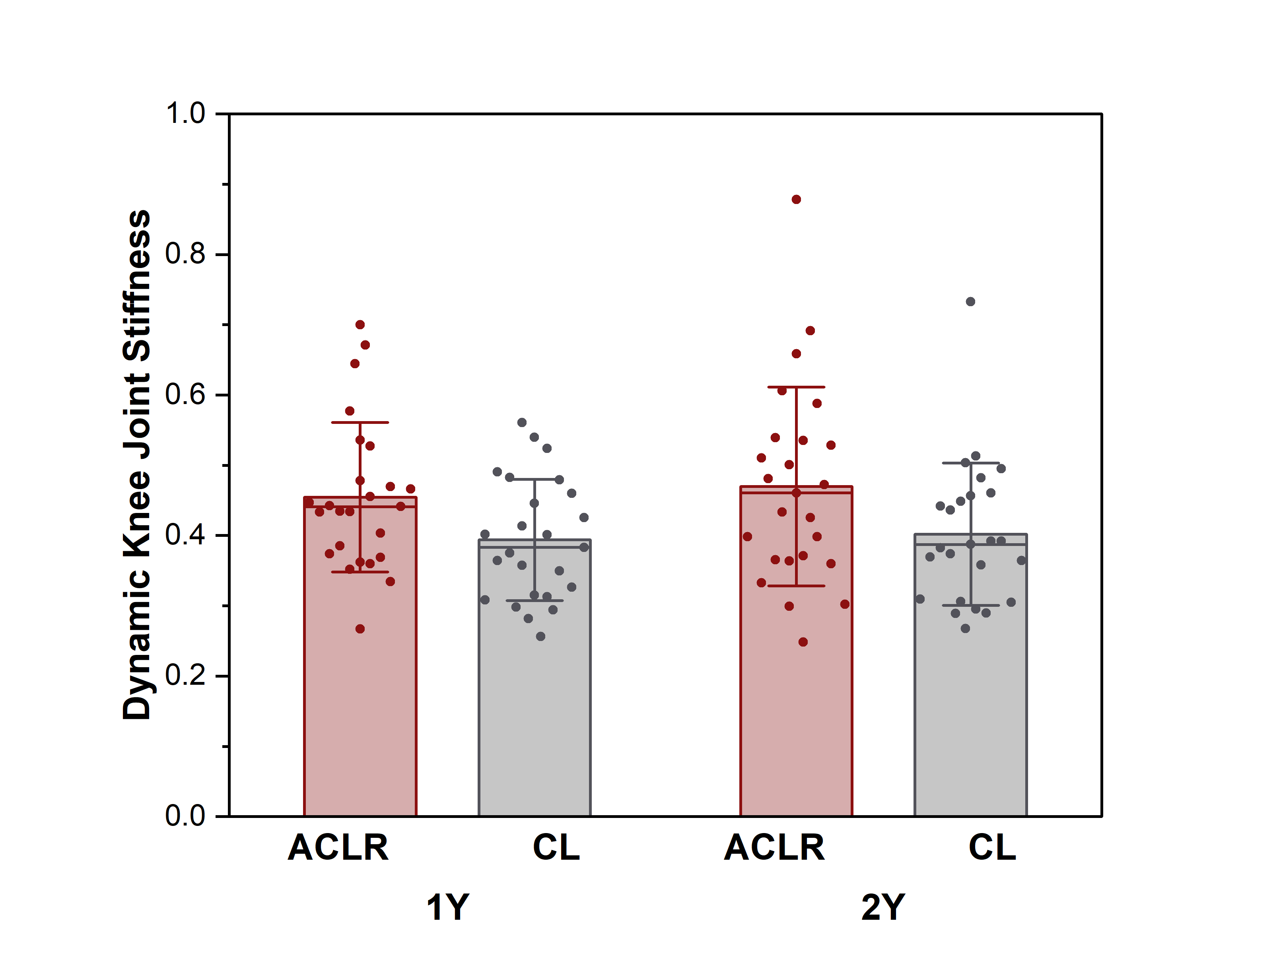
DJS between Sides and over Time
On Average
DJS is higher in ACLR than CL knees at 1 year and 2 years post-ACLR (F = 11.0, p = 0.003)
DJS is not different from 1 year to 2 years post-ACLR (F = 0.65, p = 0.426)
Estimated difference (ACLR - CL)
0.06 95%CI(0.02, 0.10)
Notes:
This could imply that patients are not further improving nor worsening throughout this time period.

Slide 13
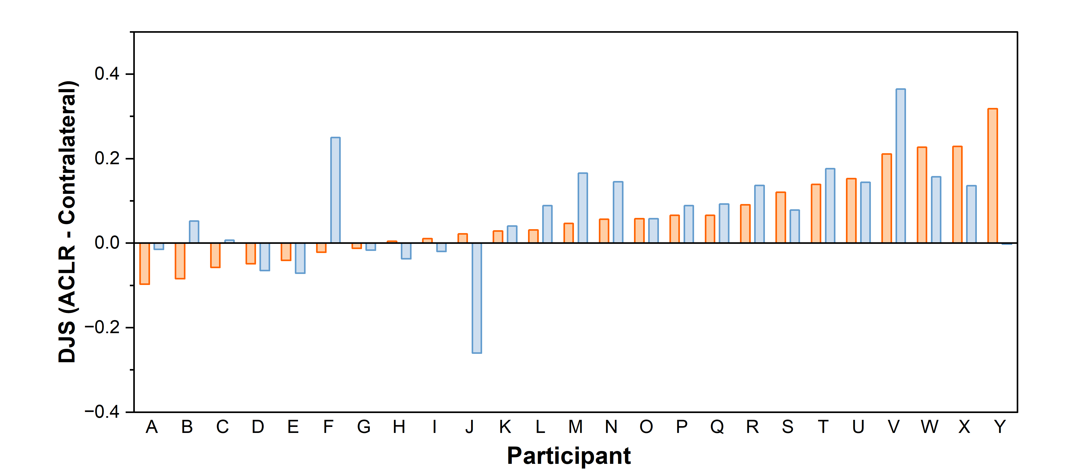
DJS between Sides and over Time
• Between individual variability was observed
diff(ACLR – CL) at 1 Y
diff(ACLR – CL) at 2 Y
76%
Notes:
While the majority of participants (79%) showed higher DJS in their ACLR knees than CL knees at both time points, several participants showed different patterns, suggesting the presence of between-individual variability.

Slide 14
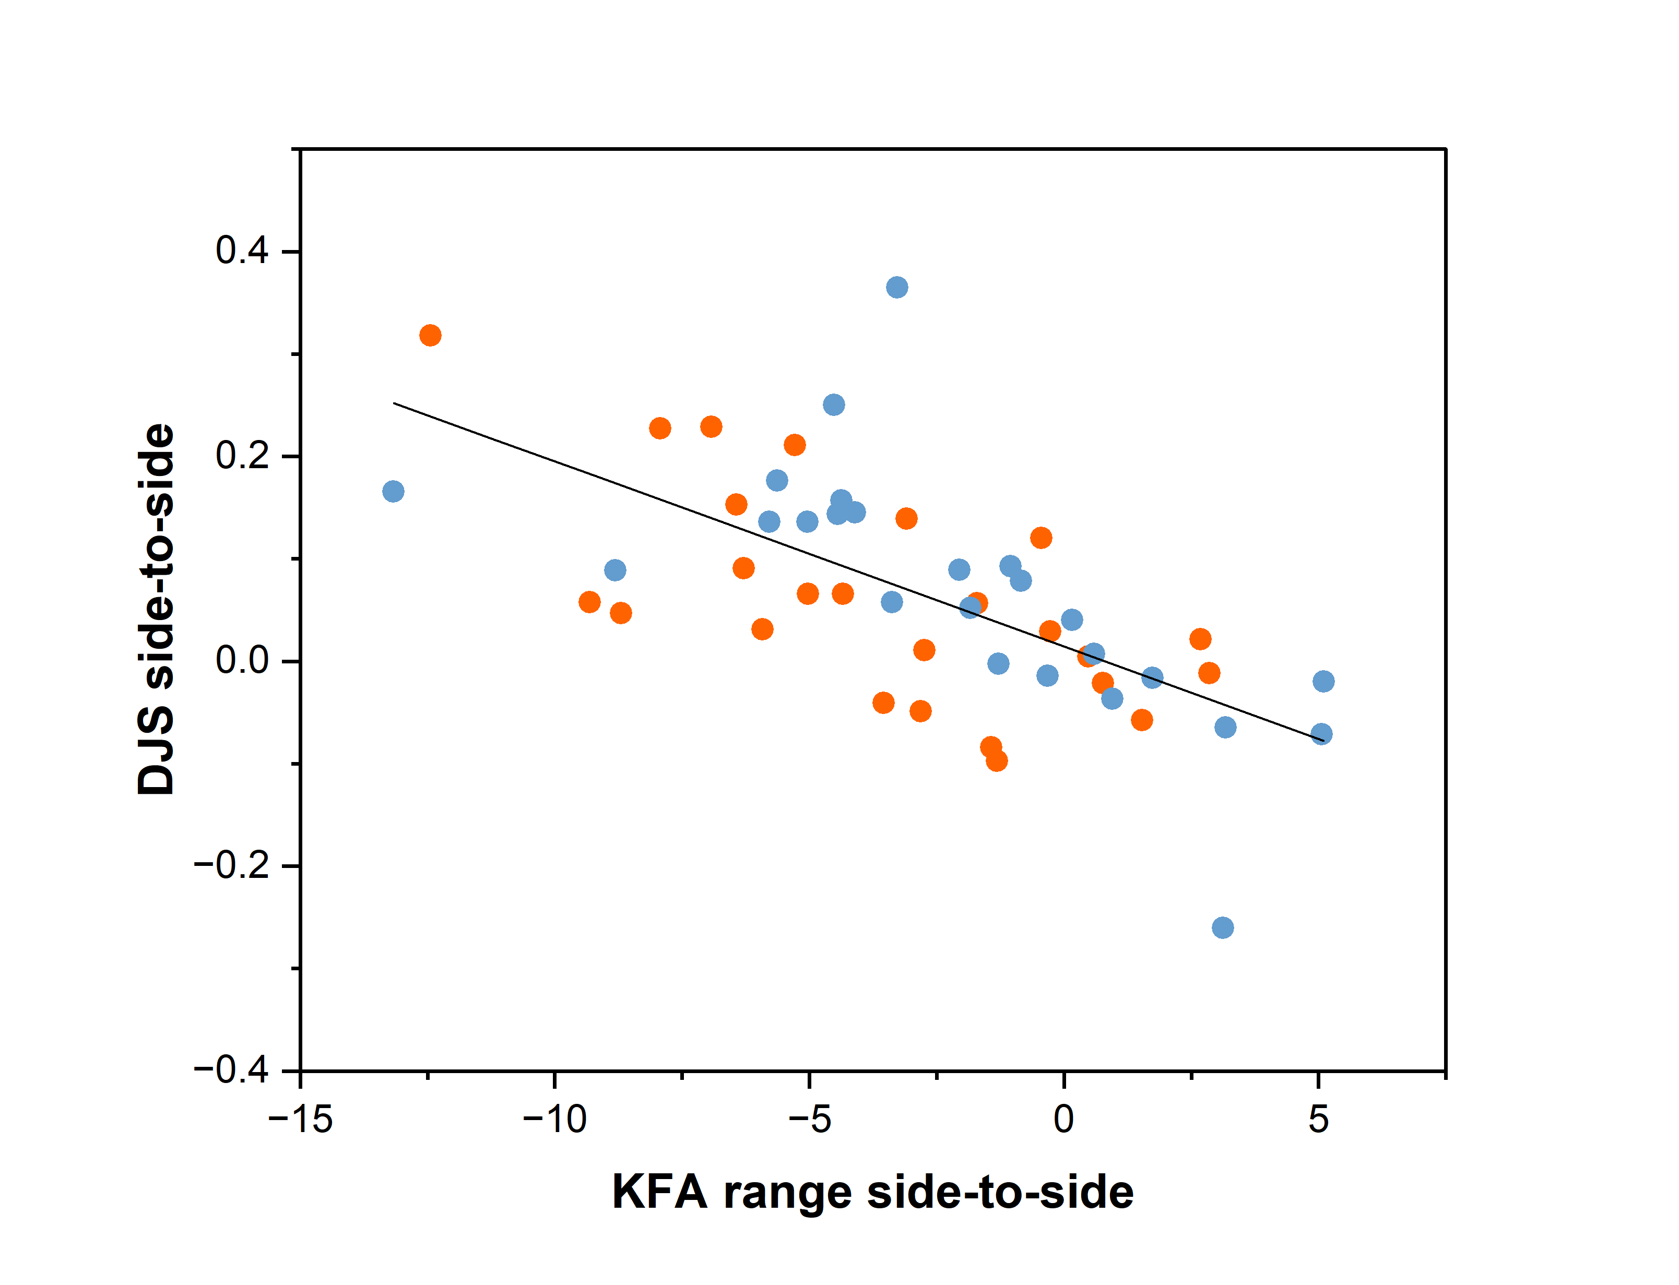
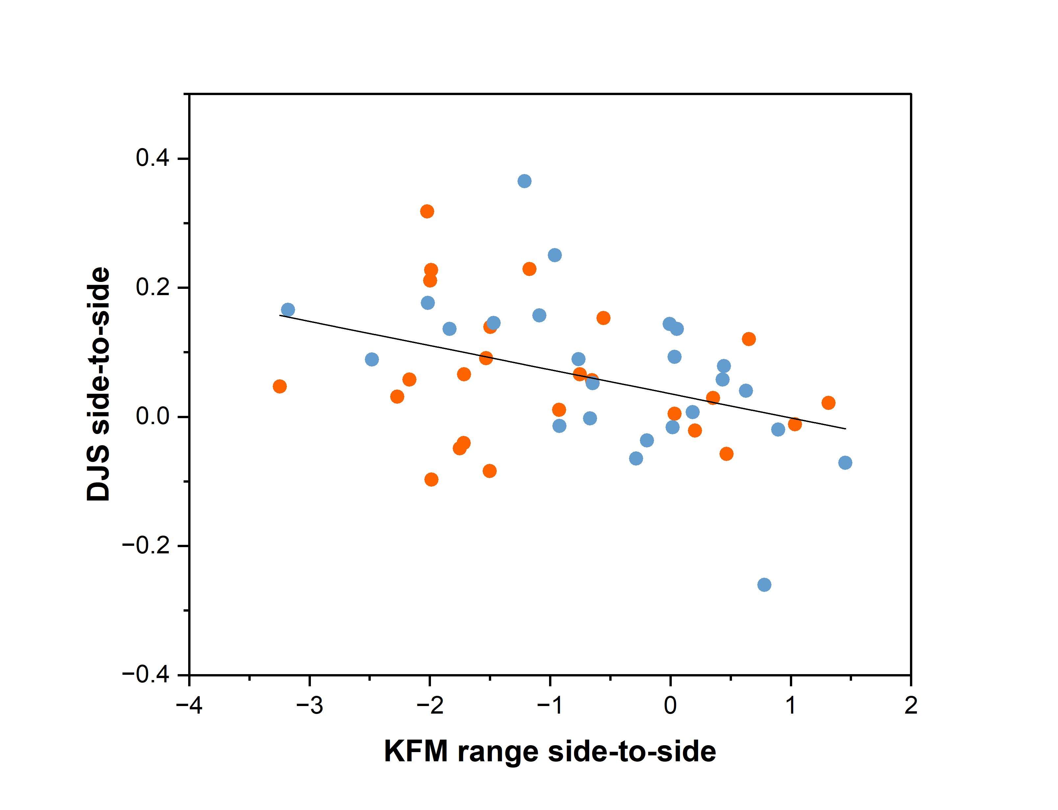
Potential Contributors to side-to-side DJS difference
Smaller KFA range and KFM range in ACLR knees than CL knees explained the side-to-side DJS difference at 1 year (R = 0.823, p < 0.001) and 2 years (R = 0.681, p < 0.001) post-ACLR
Side-to-side DJS Difference
1 year post-ACLR
2 years post-ACLR
Side-to-side KFA_{range} Difference
Side-to-side KFM_{range} Difference

Slide 15
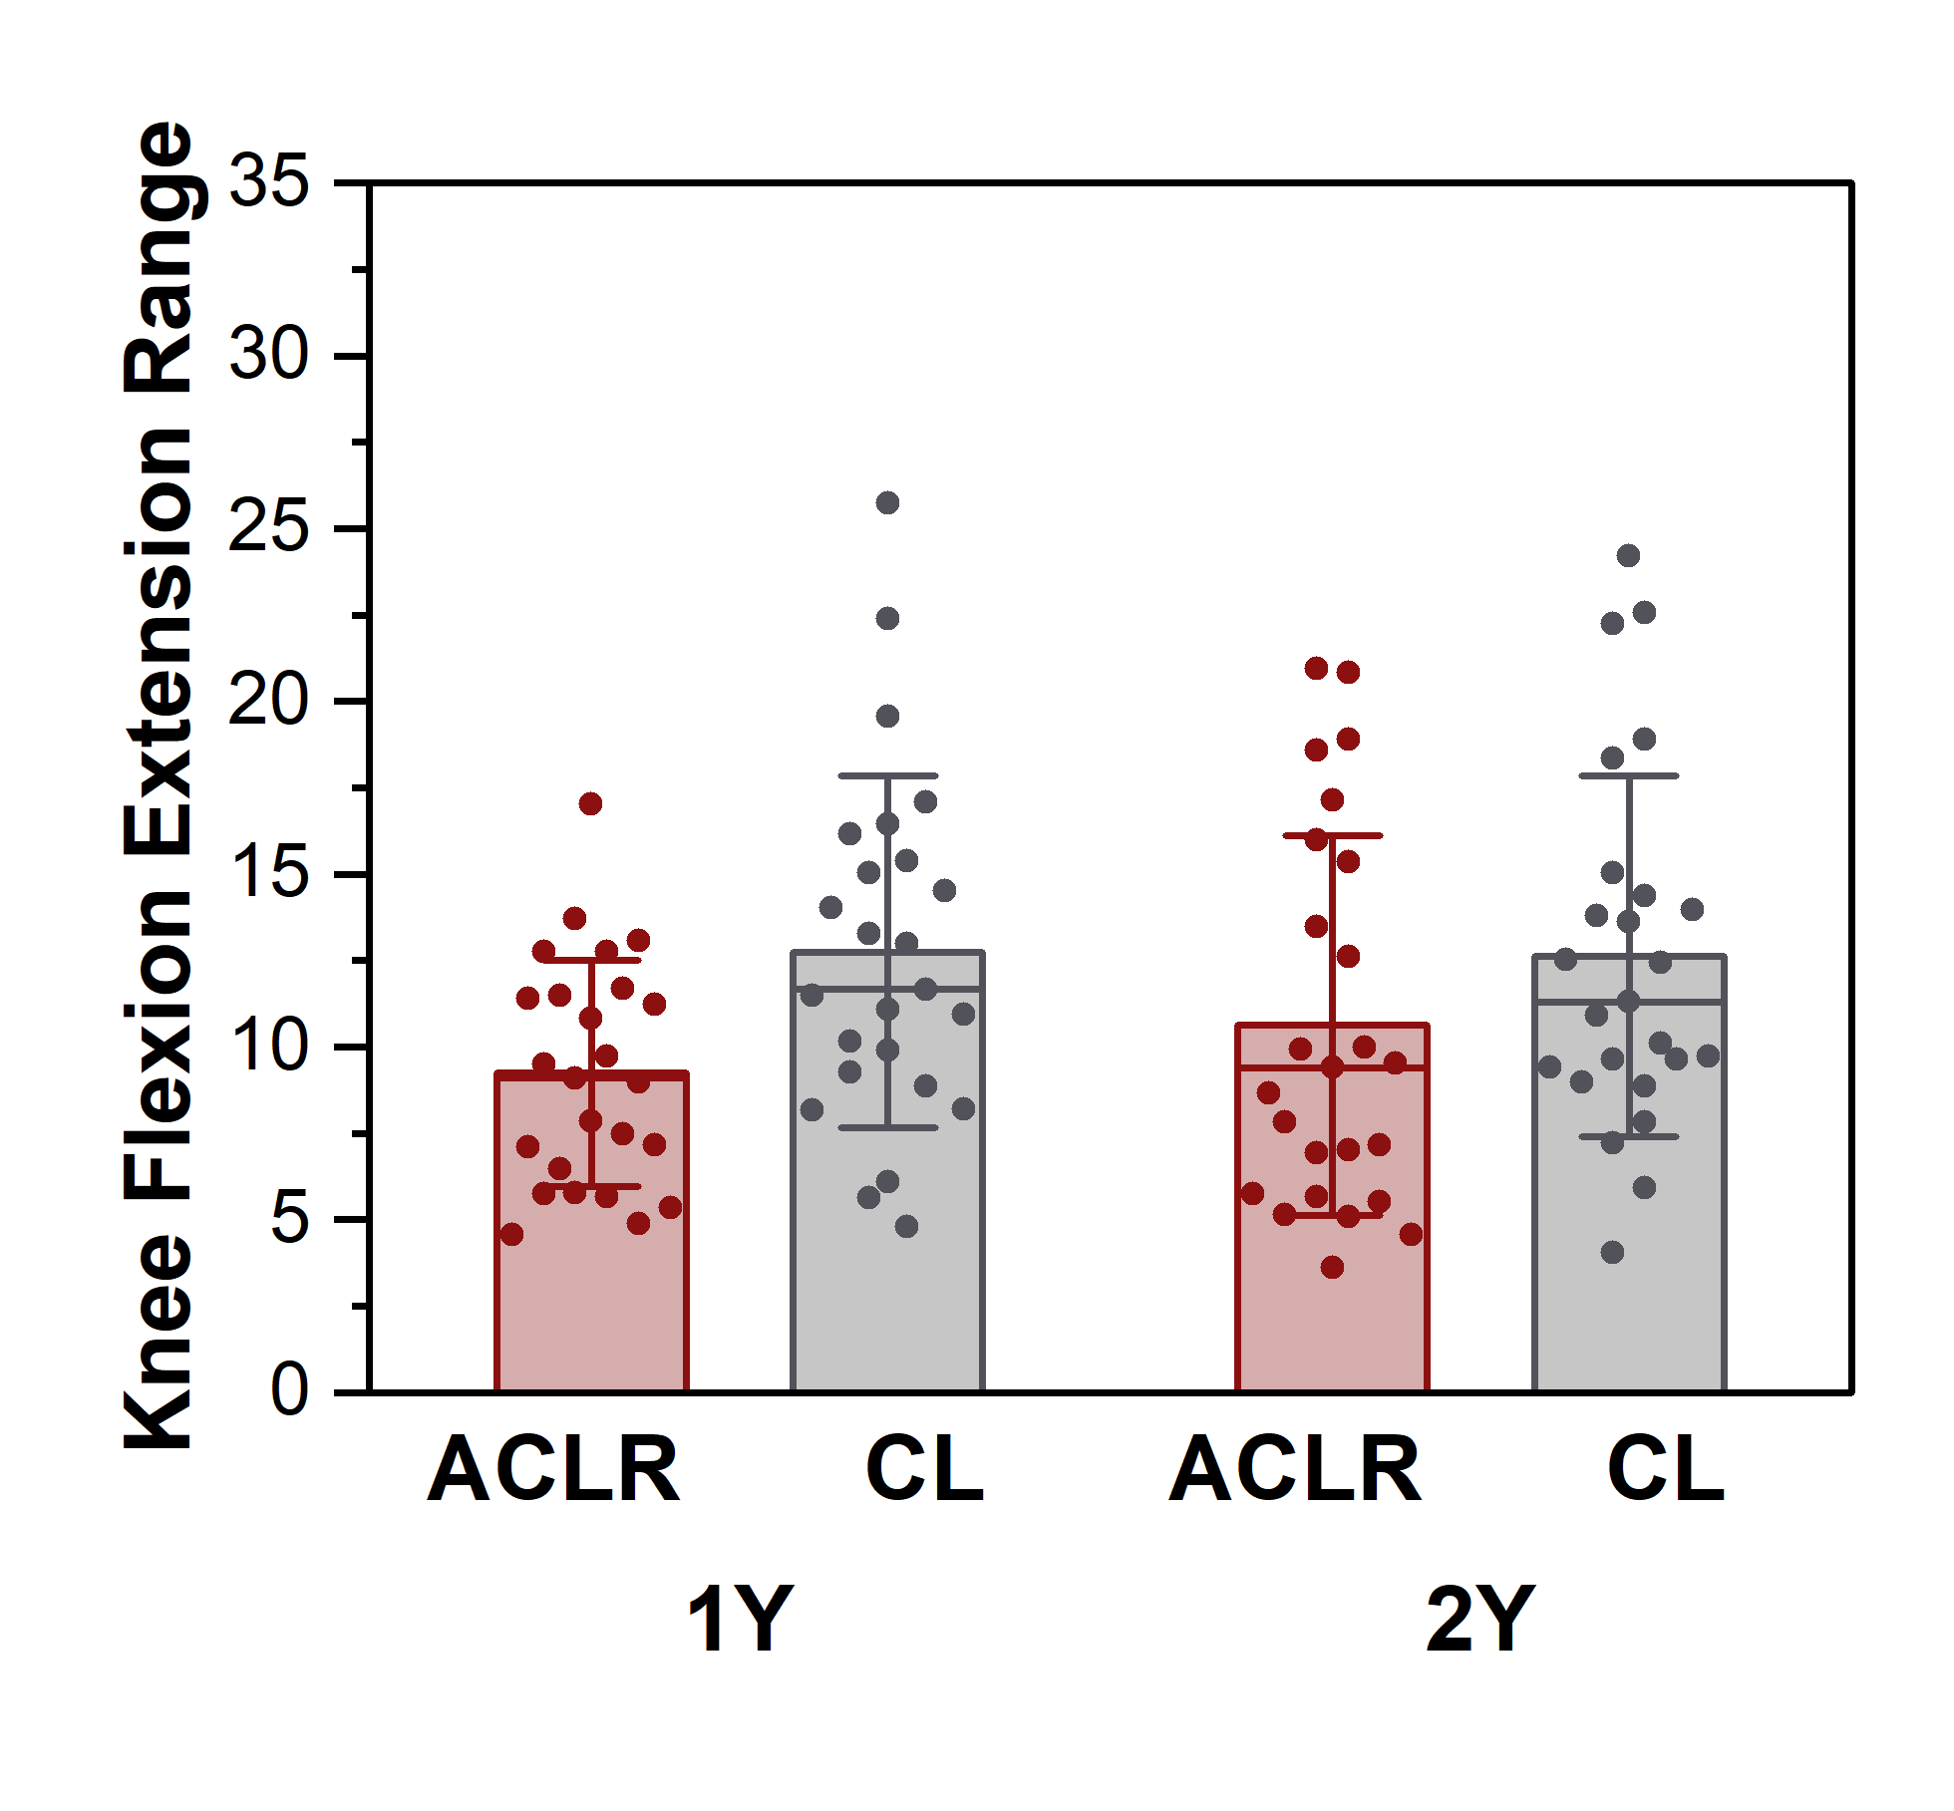
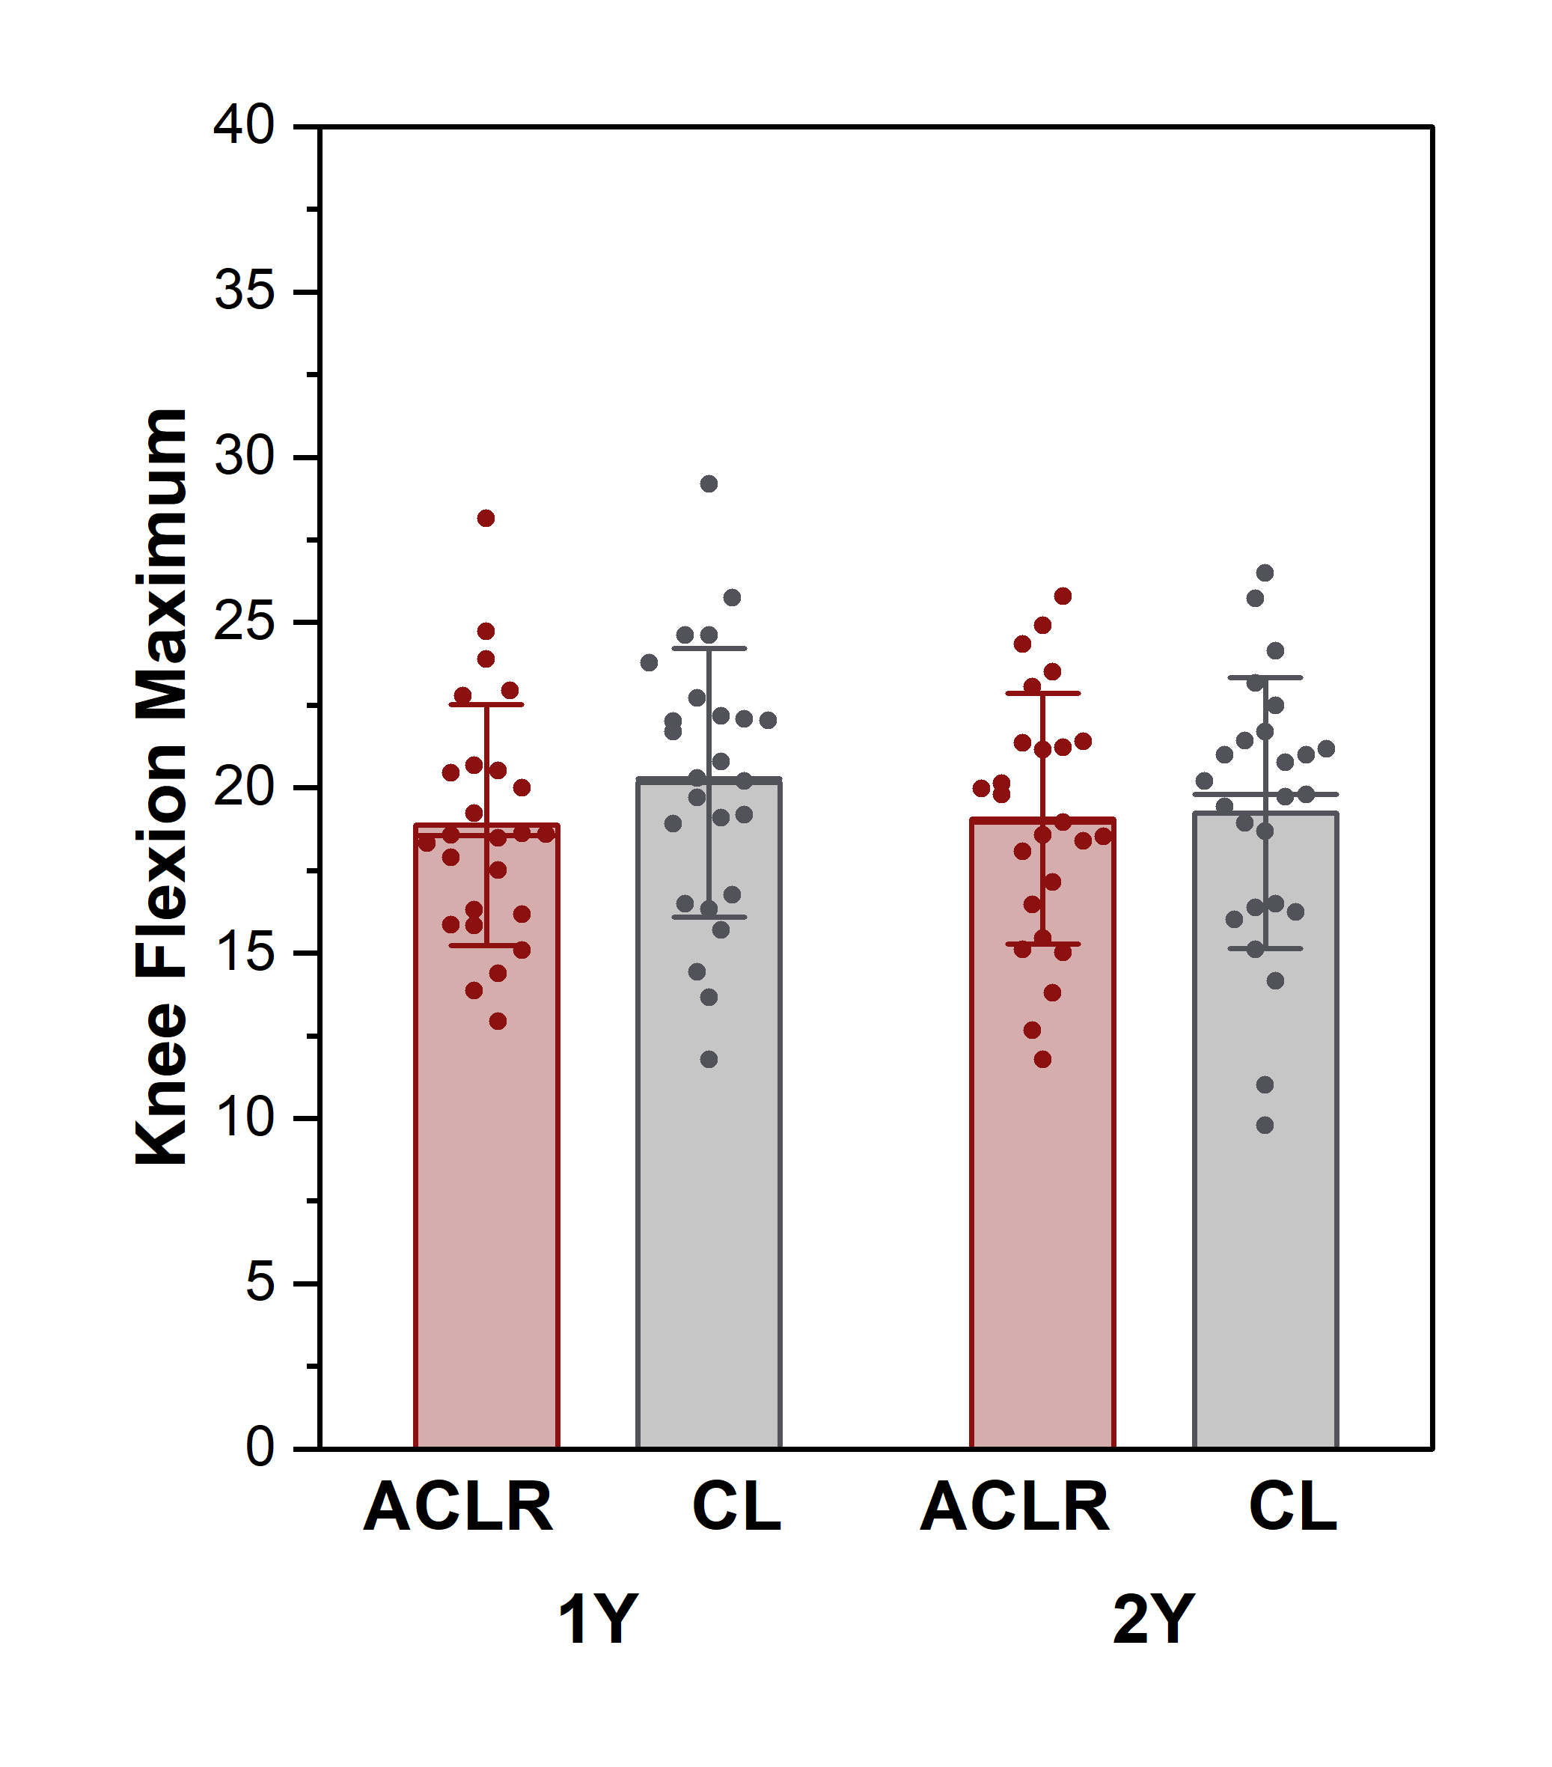
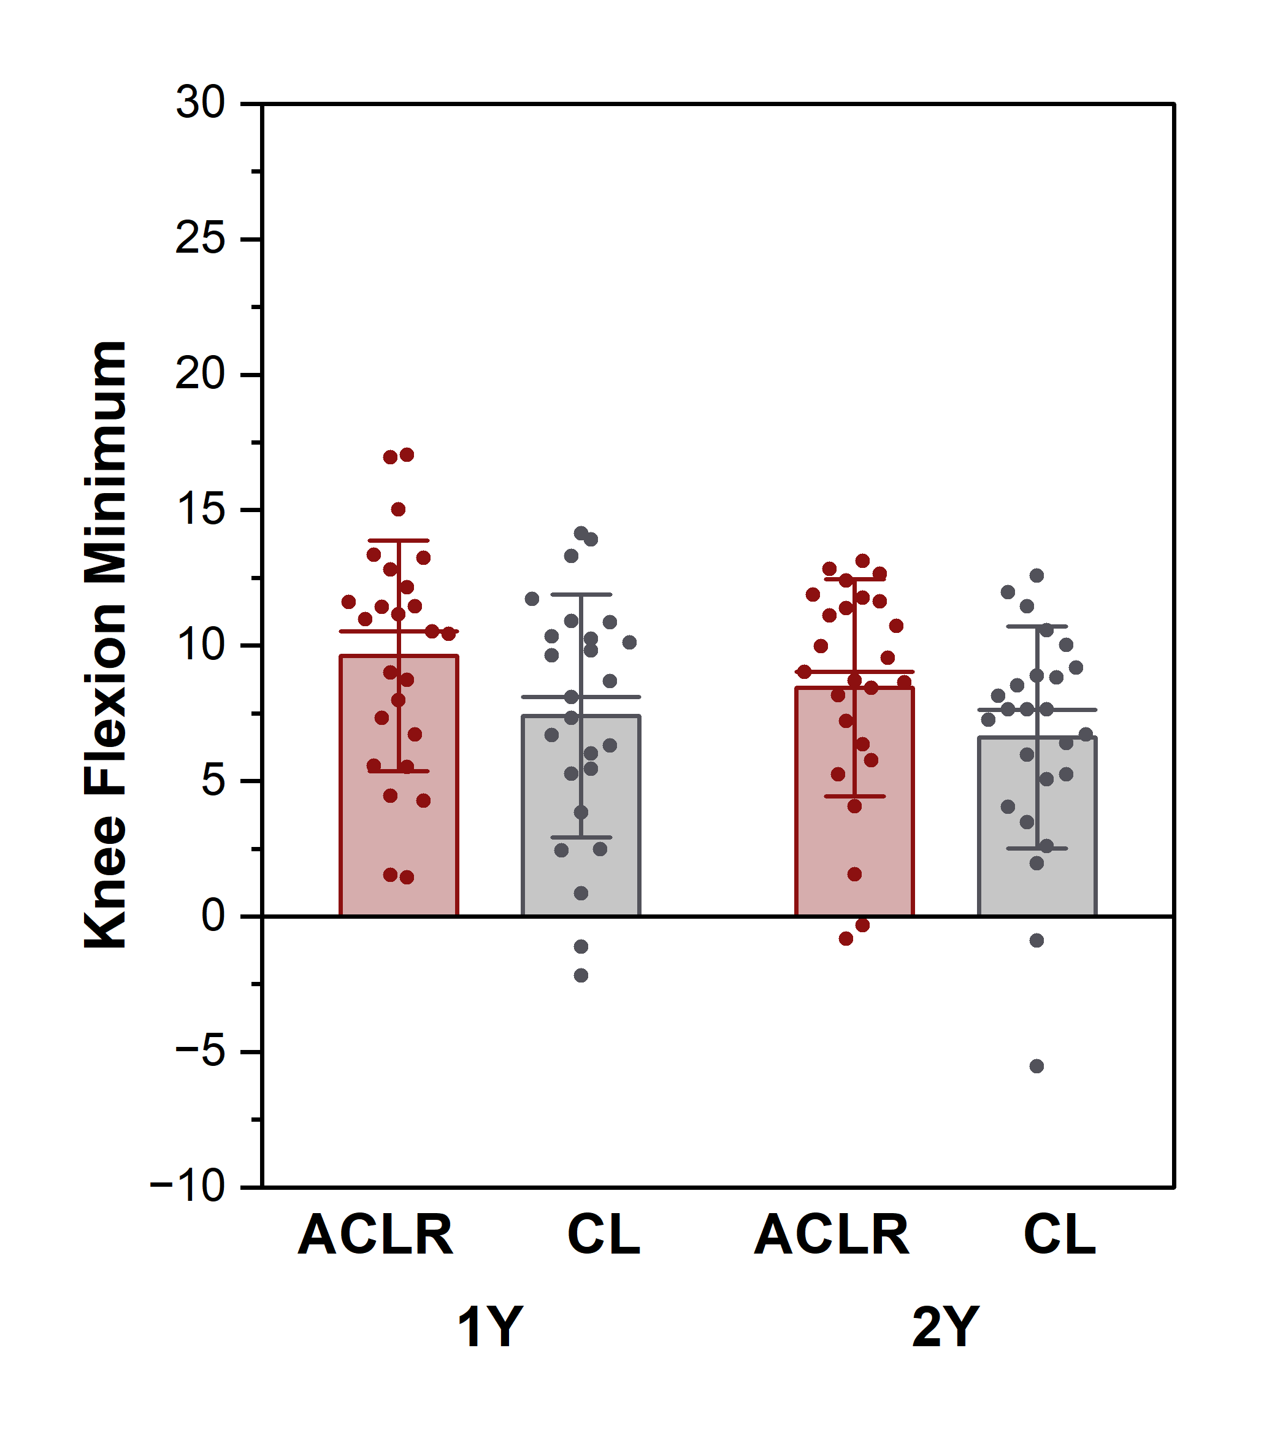
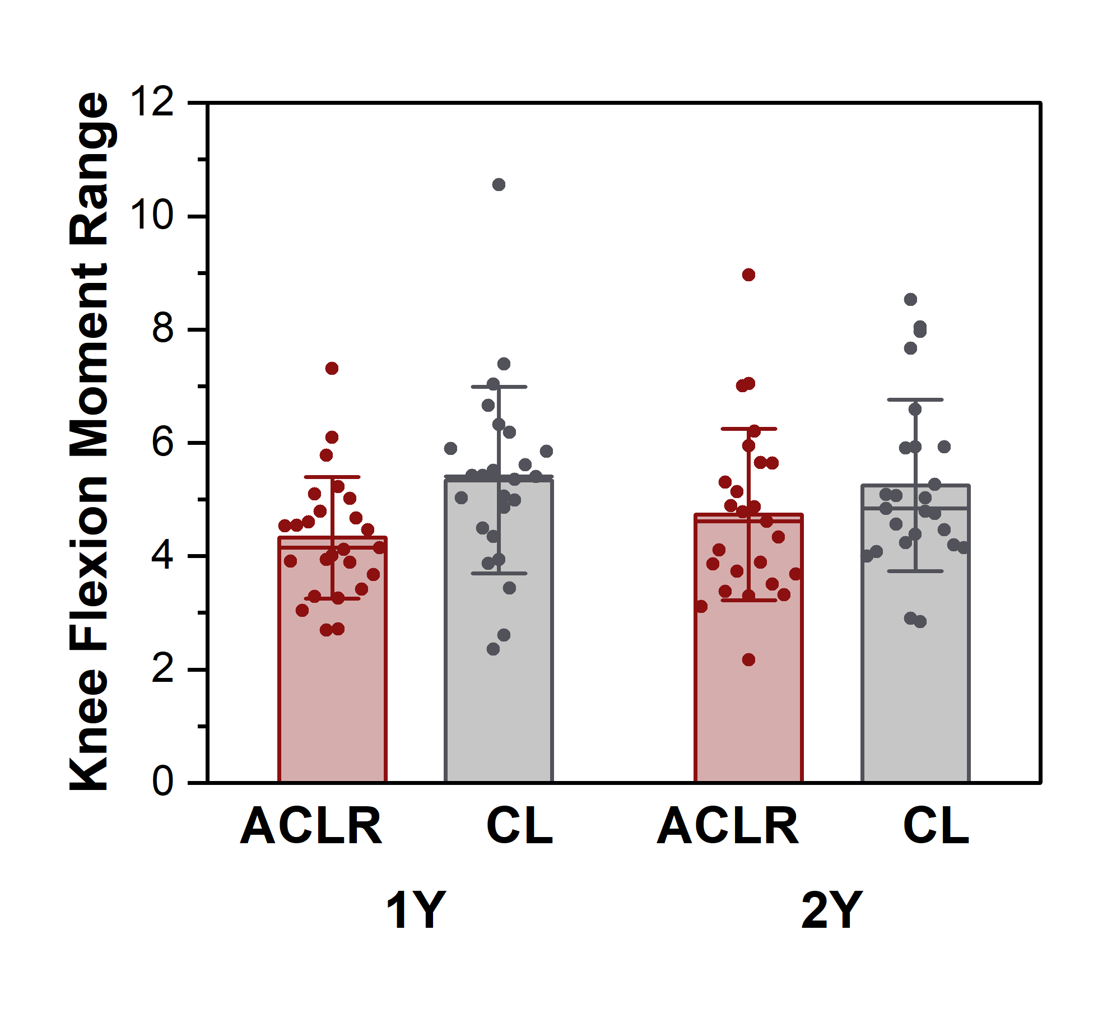
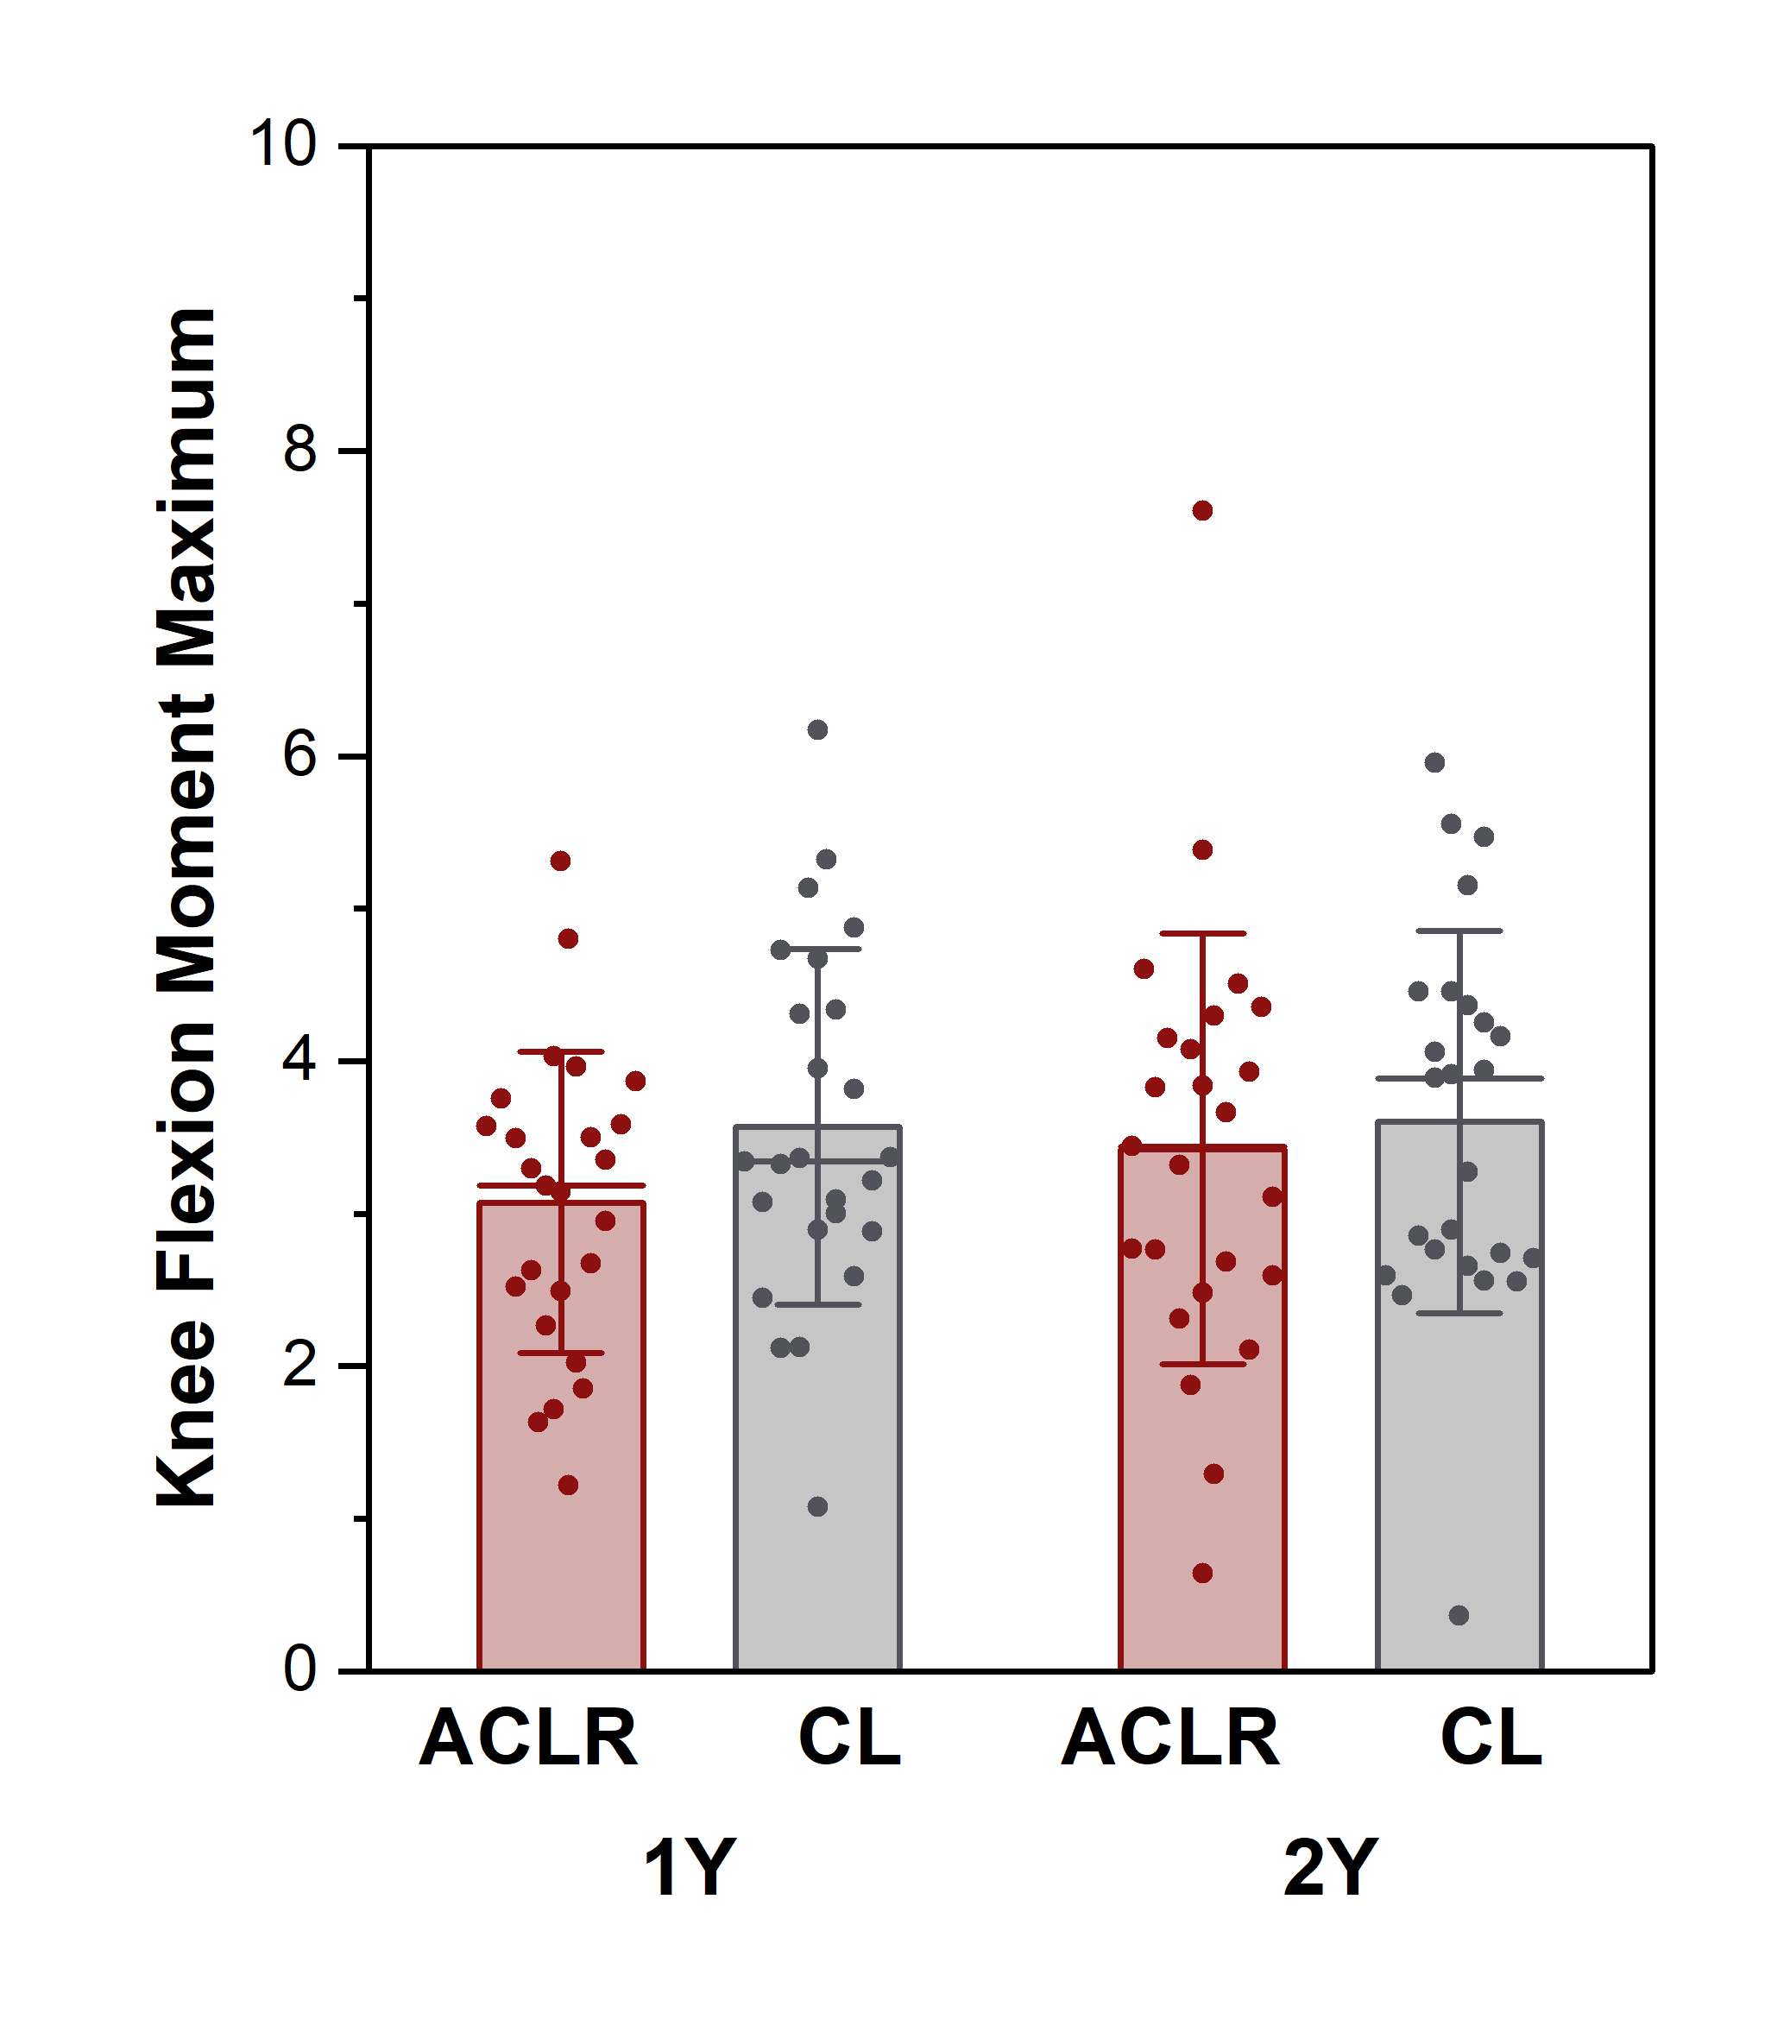
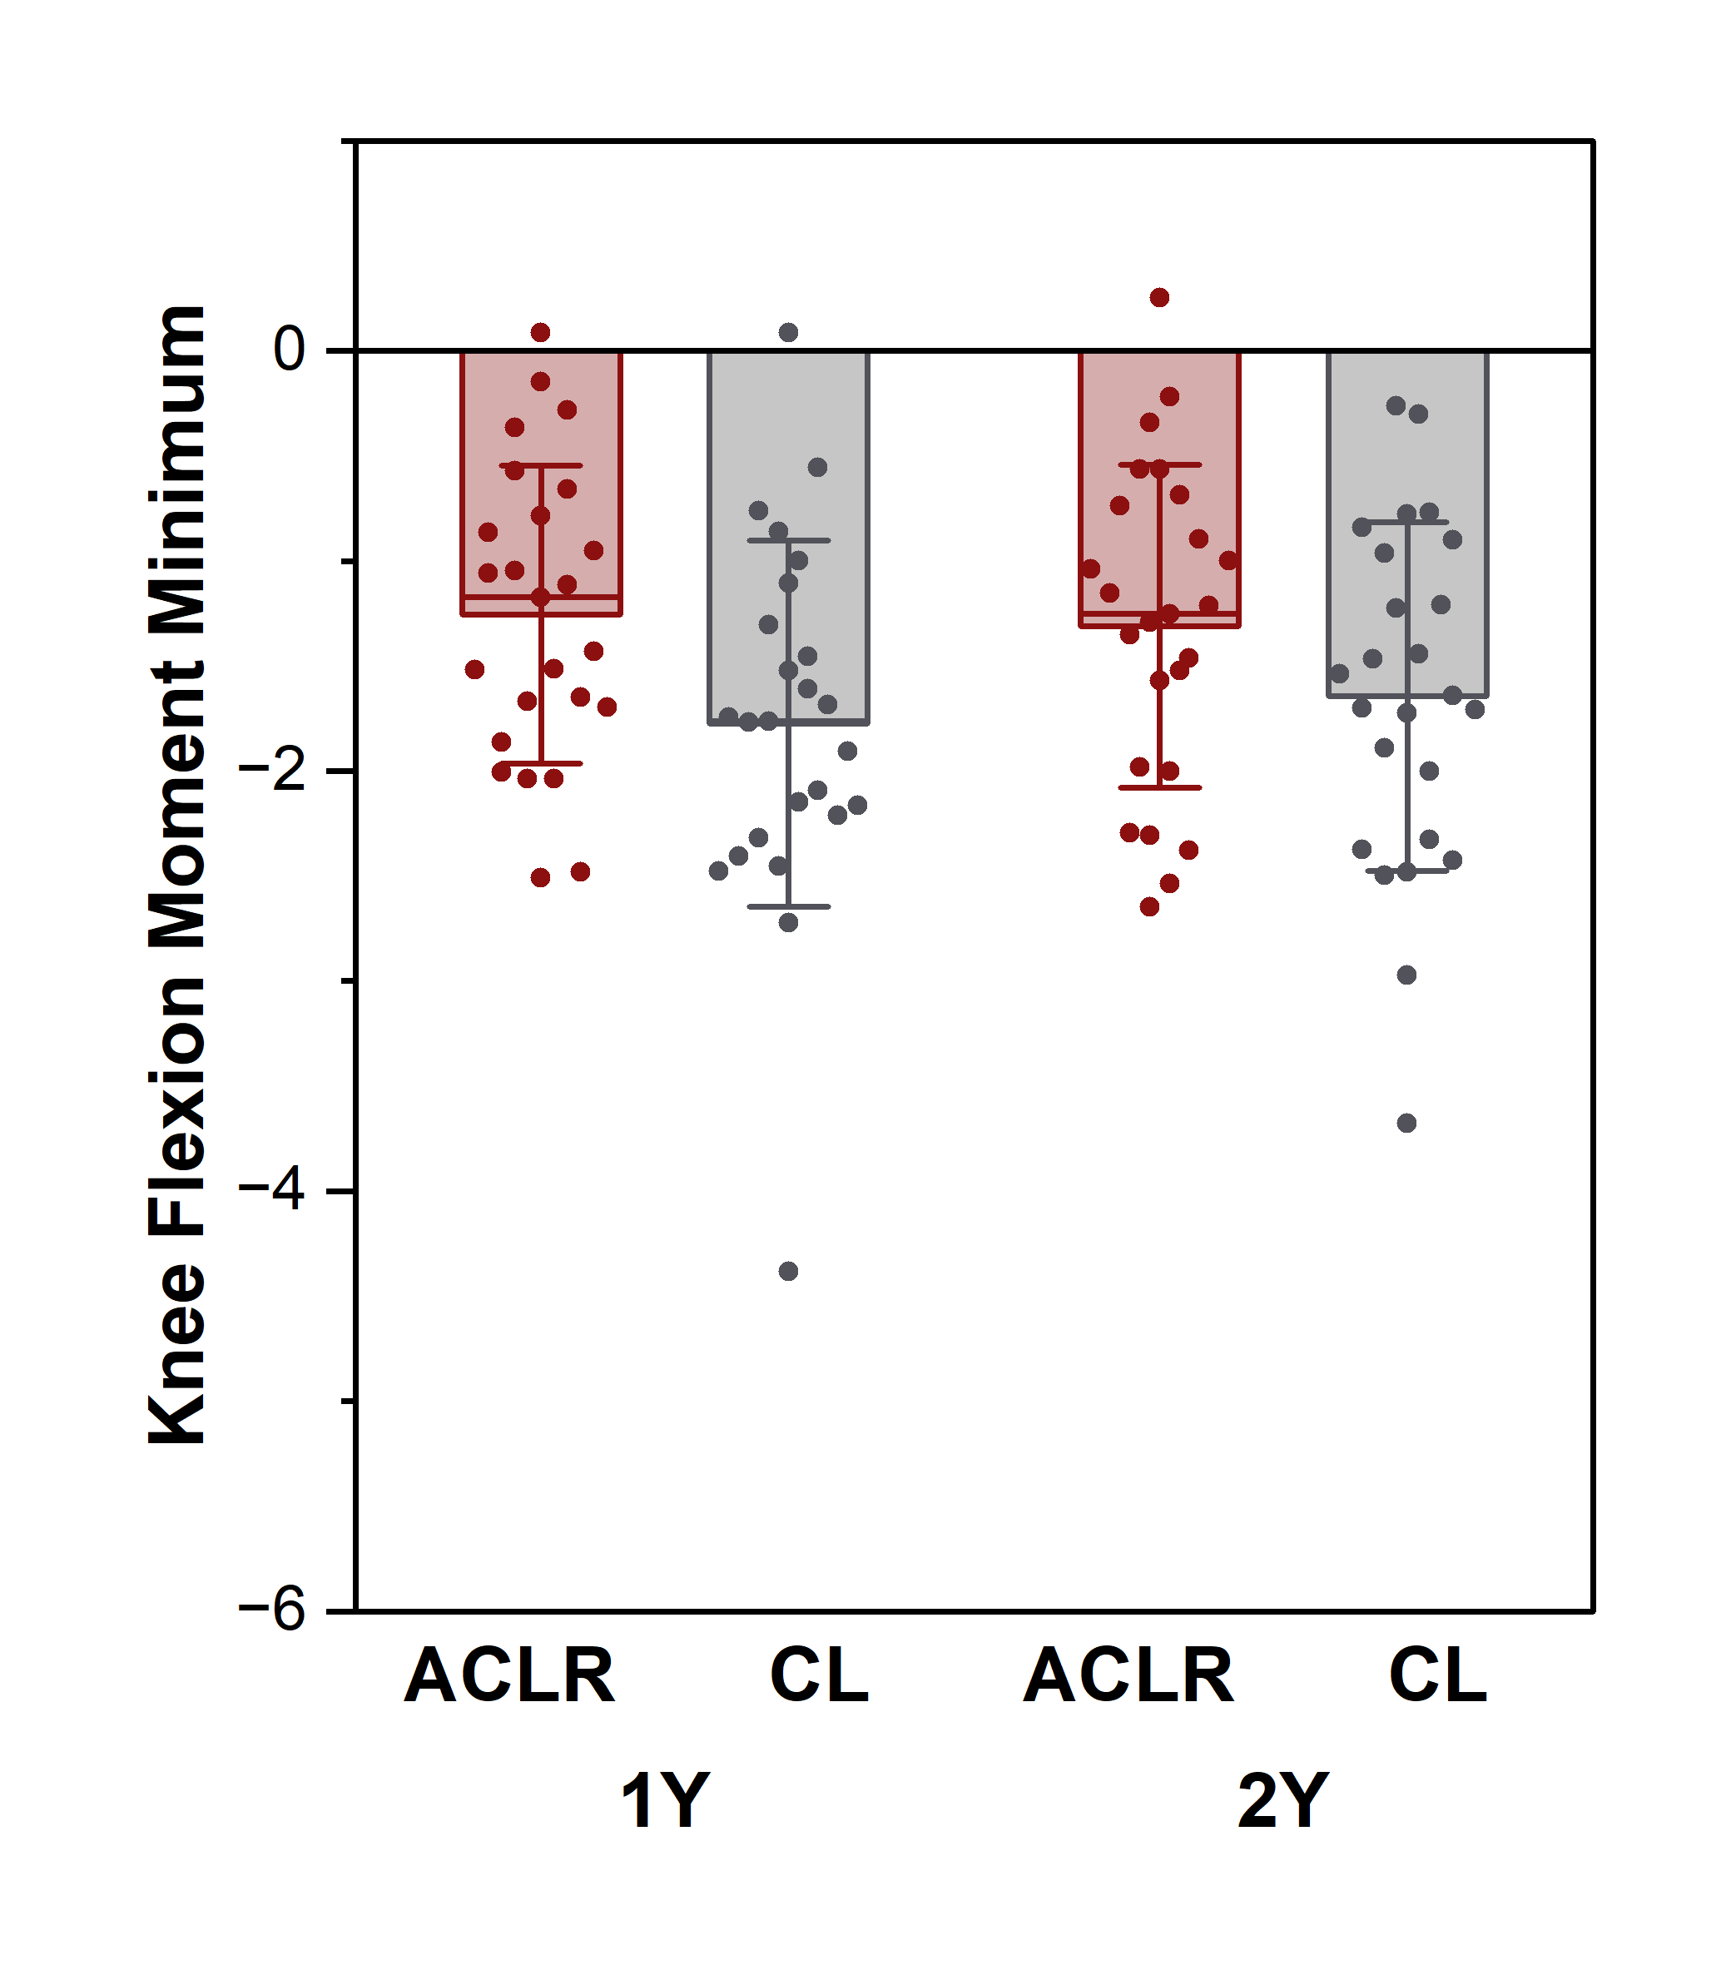
Potential Contributors to side-to-side DJS difference
KFA_{range}
KFA_{max}
KFA_{min}
Knee Flexion Angle
Estimated Side Difference
-2.75°, p < 0.%BW×Ht001
Estimated Side Difference
-0.73°, p = 0.167
Estimated Side Difference
2.02°, p = 0.013
R = 0.823, p < 0.001
R = 0.681, p < 0.001
KFM_{range}
KFM
KEM
Knee Flexion Moment
Estimated Side Difference
-0.76 %BW×Ht, p < 0.001
Estimated Side Difference
-0.34 %BW×Ht, p = 0.020
Estimated Side Difference
0.43 %BW×Ht, p = 0.006

Slide 16
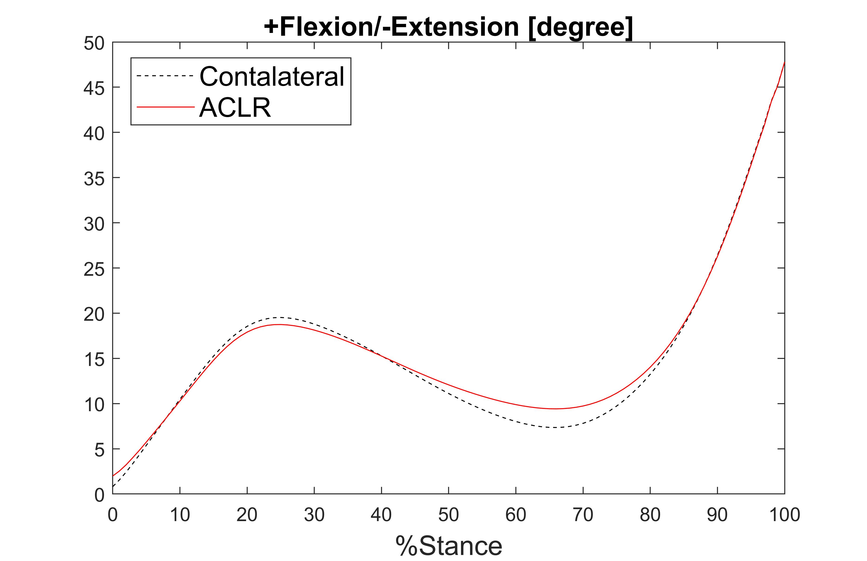
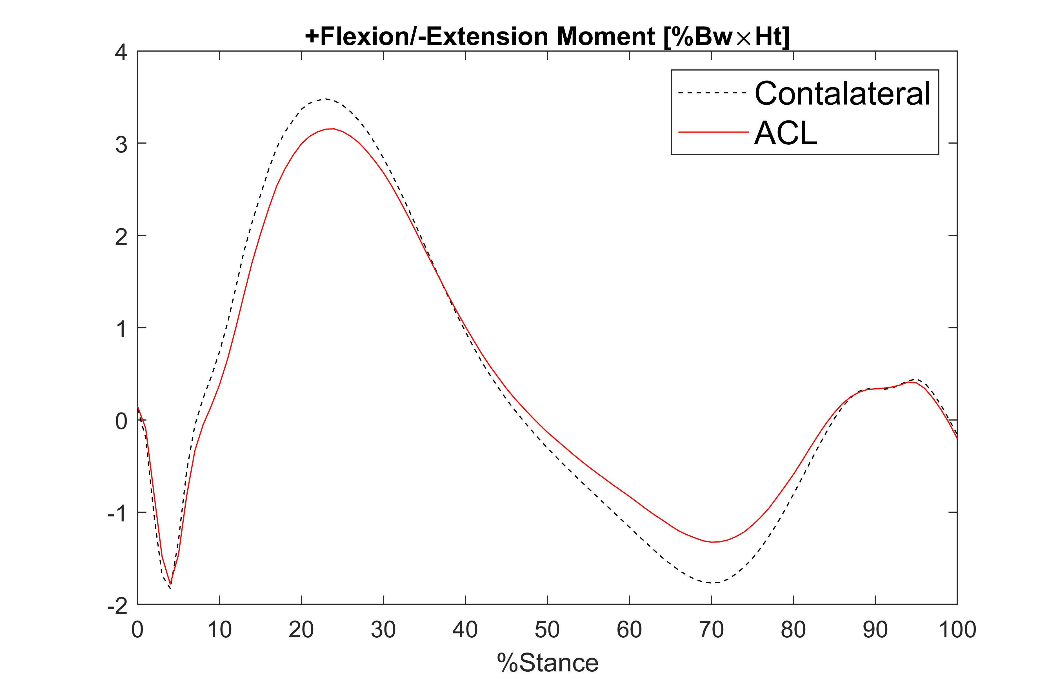
DJS and Knee Moment & Angle Range
Point out red = aclr, dashed line = con.
Notes:
Too many lines

Slide 17
DJS and Knee Angle Range
Smaller Range of Motion and Extension Loss
KFA_{range}
p < 0.001
p = 0.167
p = 0.013
Notes:
Need higher resolution figure

Slide 18
DJS and Knee Angle Range Discussion
Loss of extension may reflect:
Reduced quadricep strength
KFA_{range}
p < 0.001
Notes:
Need higher resolution figure

Slide 19
DJS and Knee Moment Range
External Flexion Moment
External Extension Moment
KFM_{range}
p < 0.001
Notes:
Too many lines
Change to external bc that’s how we reference it in the abstract?

Slide 20
DJS and Knee Moment Range Discussion
Late Stance
Why Decreased KEM?
Decreased internal flexor moment
Weaker hamstrings
Increased quadricep-hamstring co-activity
Force
Knee is more flexed so the lever arm is smaller, generating less moment force
Hamstring main muscle counteracting the ground reaction force torque, so hamstring could be weaker 3. altered activity of the quadricep (weak -> more activation, therefore a little less hamstring activation)
Knee is more flexed so the lever arm is smaller, generating less moment force
Hamstring main muscle counteracting the ground reaction force torque, so hamstring could be weaker 3. altered activity of the quadricep (weak -> more activation, therefore a little less hamstring activation)
Notes:
Too many lines
Change to external bc that’s how we reference it in the abstract?

Slide 21
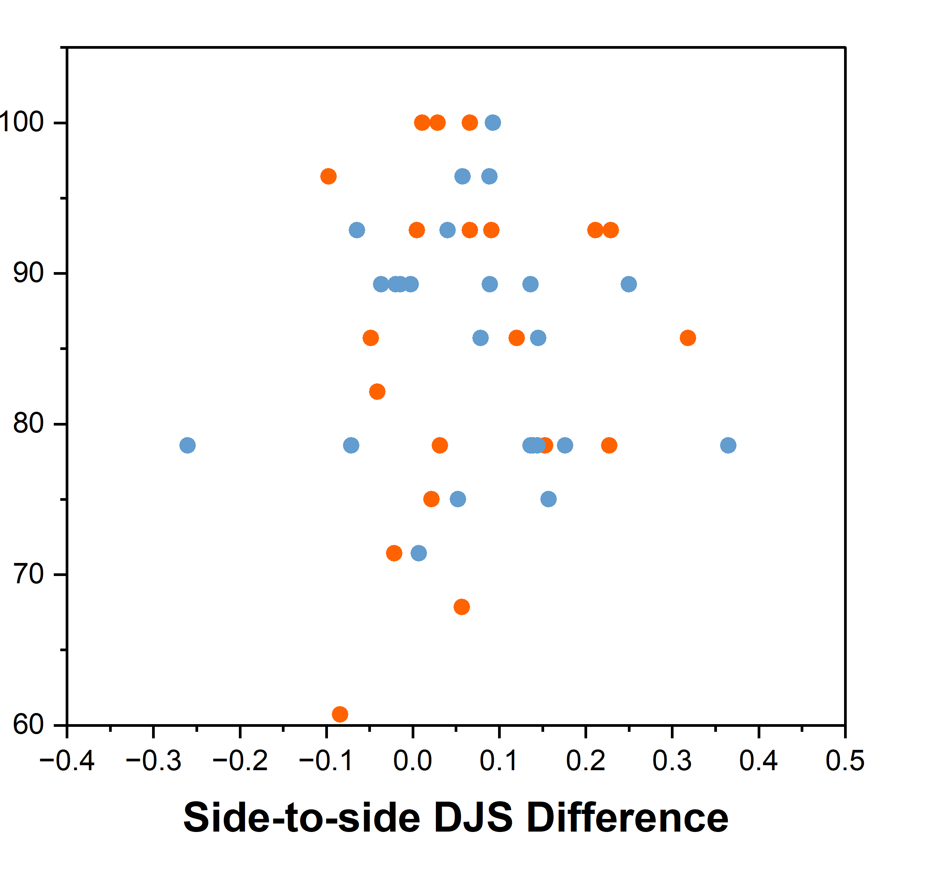
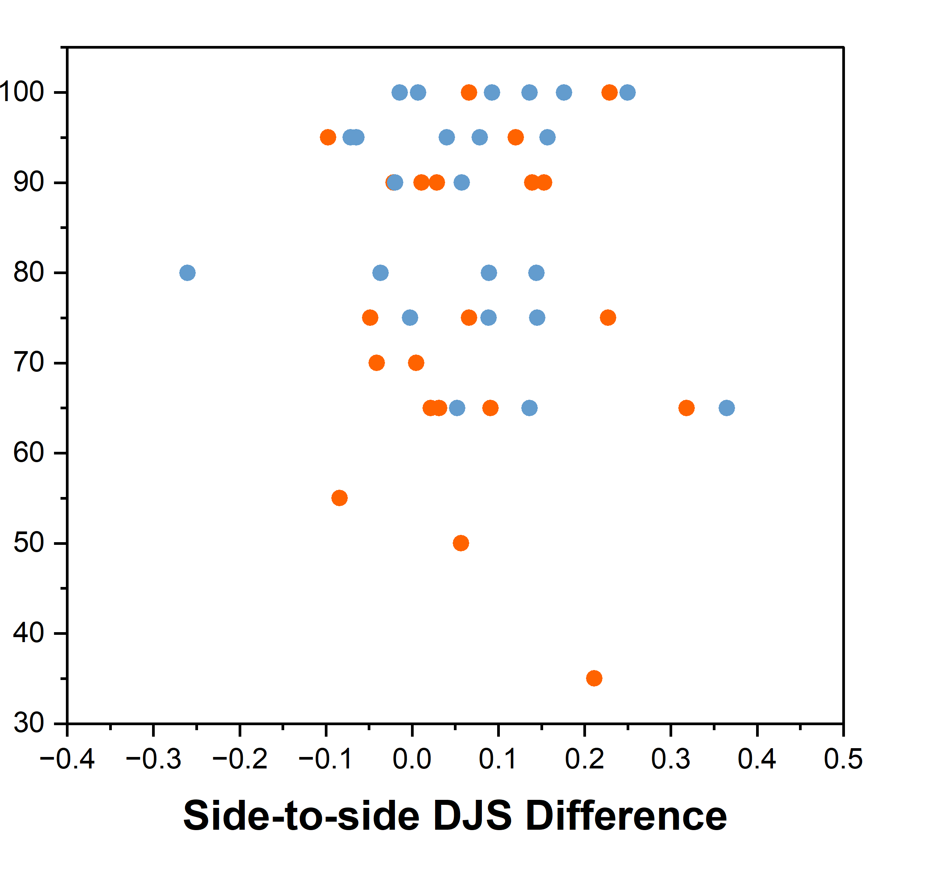
Assessing DJS and Patient Reported Outcomes
Symptom
Sport/Rec
No correlation found between time or side differences 1 and 2 years post ACLR.
These might relate to the high variability in PROs among the participants.

Slide 22
Summary and Take-Home Message
Aberrant quadricep and hamstring activation not fully restored in a majority of patients. Interventions can potentially address this issue.
DJS is higher, on average, in ACLR than CL at 1 year and 2 years. DJS is not different from 1 year to 2 years post-ACLR.
No relation between DJS and PROs found.
Take-Home Message: DJS can quantitatively measure abnormal knee mechanics post-ACLR to help identify patients who may benefit from additional interventions to improve knee function and longer term joint health.

Slide 23
Chu Lab
Acknowledgement
Dr. Jade He, Dr. Constance Chu, Adam Wadsworth, Ashley Williams
VA Volunteer Research Office
Funding
R01 AR052784 (PI: Chu)
Contact
chucr@stanford.edu
Lab website:
Notes:
Not answering pro question?

Slide 24
Knee Recovery Measurement
Knee Mechanics⁵
Knee flexion moment (KFM)
PROs with Knee injury and Osteoarthritis Outcome Score: KOOS³
Pain, other Symptoms, Function in daily living (ADL), Function in Sport and Recreation (Sport/Rec), and knee-related Quality of Life (QOL)
¹Muller B, et al. AJSM 2016. ³Larsen P et al, Knee 2023.. ⁵Titchenal MR, et al. Am J Sports Med 2018.

Slide 25
DJS and Knee Moment & Angle Range
Midstance knee ROM was reduced in the ACLR knees compared to the CL knees (-2.75 (-4.20, -1.30) °, p < 0.001), attributable to greater flexion at the time of KEM2 (2.02 (0.47, 3.58)°, p = 0.013). The narrower range of knee moment and ROM in the ACLR knee explained significant variance of the side-to-side difference in midstance DJS at 1 and 2 years post-ACLR (R = 0.823, p < 0.001; R = 0.681, p < 0.001, respectively).
Notes:
I have a good visual to illustrate how a more flexed knee during late stance is related to a more positive KEM2. Will share. -Jade

Slide 26
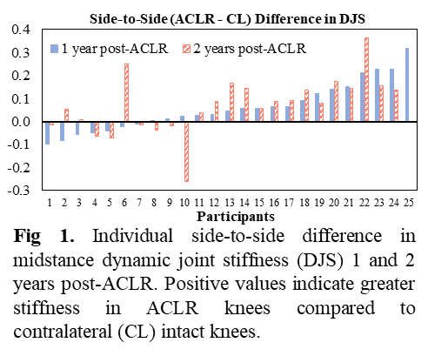
DJS between Sides and over Time
The majority of subjects, 19 out of 25 (76%), showed greater DJS in their ACLR knees compared to CL knees at both time points
3 (12%) participants showed greater DJS at 1 year and lower DJS 2 years post-ACLR
3 (12%) showed the opposite pattern
Less detail
A few who showed…
76%

